Slide 1
Matrix Algebra
2.6 Subspaces of ℝ^{n}
Bumhee Cho

Slide 2






Subspace of ℝ^{n}
Any set H in ℝ^{n} that has three properties:
a. The zero vector is in H
b. For each u and v in H, the sum u + v is in H
c. For each u in H and scalar c, the vector cu is in H
closed under addition and scalar multiplication
zero vectors in ℝ^{n} is called the zero subspace

Slide 3

Example 1.
v₁ and v₂ are in ℝ^{n} and H = Span{v₁, v₂}
0v₁ + 0v₂ = 0
u = s₁v₁ + s₂v₂
v = t₁v₁ + t₂v₂
u + v = (s₁+t₁)v₁ + (s₂+t₂)v₂
u = s₁v₁ + s₂v₂
cu = c(s₁v₁ + s₂v₂) = cs₁v₁ + cs₂v₂
v₁,…, v_{p} in ℝ^{n}, Span{v₁,…, v_{p}} is a subspace of ℝ^{n}

Slide 4
Example 2.
x₂
v
u + v
2u
u
x₁
L

Slide 5

Column Space
The column space of a matrix A is the set Col A of all linear combinations of the columns of A
ℝ^{m}
Col A = Span{a₁,...,a_{n}}
Supspace of ℝ^{m}
Is b in Col A?
Is Ax = b consistent?

Slide 6
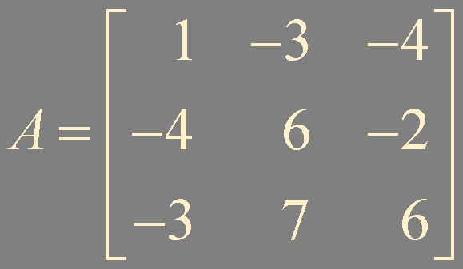
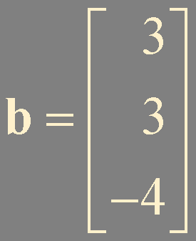
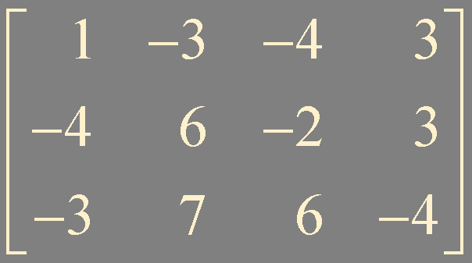
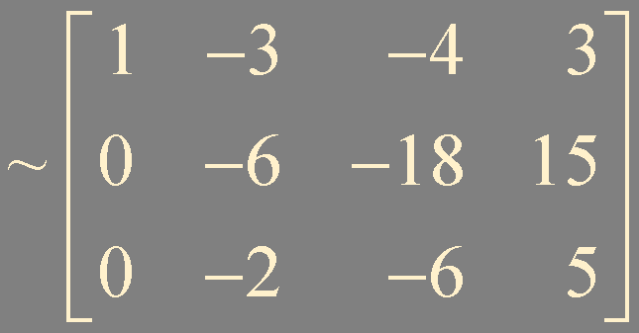
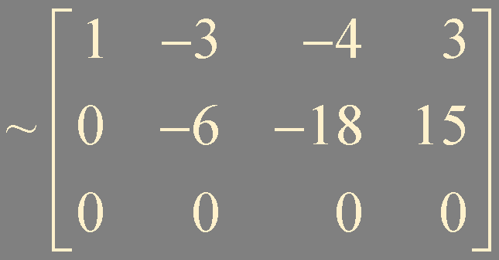

Example 3. Is b in Col A?

Slide 7
Null Space
Is u in Nul A?
The null space of a matrix A is the set Nul A of all solutions to the homogeneous equation Ax = 0
Is Au = 0?
Theorem 11.
The null space of an m × n matrix A is a subspace of ℝ^{n}.
Equivalently, the set of all solutions to a system Ax = 0 of m homogeneous linear equations in n unknowns is in a subspace of ℝ^{n}
A0 = 0
null space is defined implicitly
column space is defined explicitly
Au = 0
Av = 0
A(u + v) = Au + Av = 0
Au = 0
Acu = c(Au) = 0

Slide 8
Basis for a Subspace
H = Span{u, v}
w
Span{u, v, w}
Span{u, v, w, ...}
A basis for a subspace H of ℝ^{n} is a linearly independent set in H that spans H

Slide 9
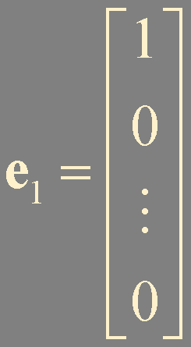
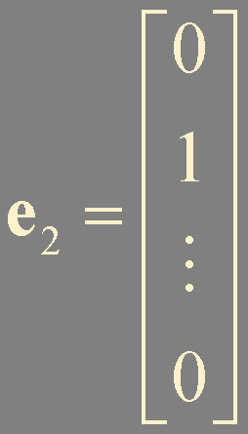
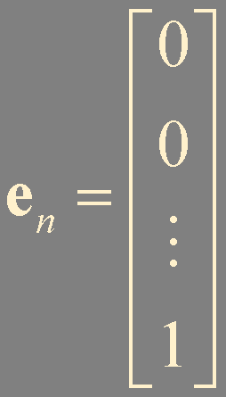

Standard Basis for ℝ^{n}
…
x₃
e₃
x₂
e₂
e₁
x₁

Slide 10
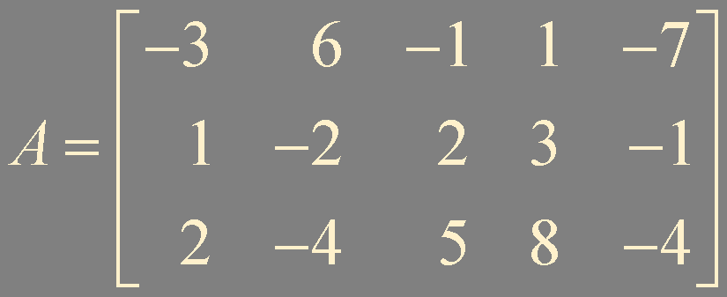
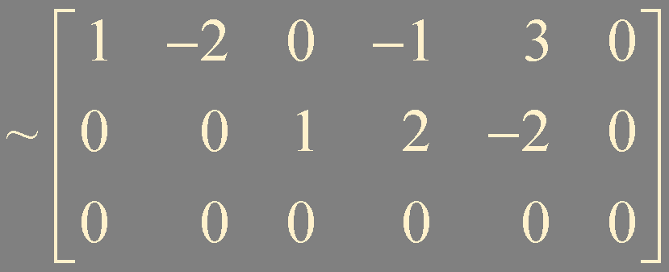
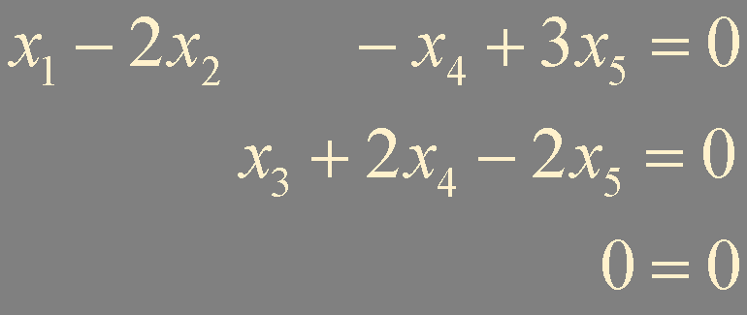
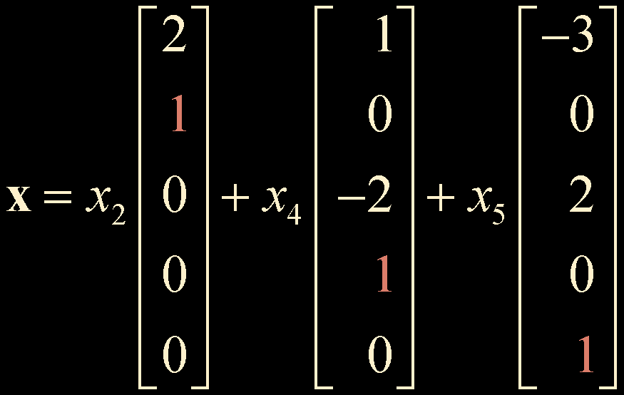

Example 4. Find a basis for the null space of the following matrix
[ A 0 ]
{u, v, w}
Notes:
homogeneous equation 의 general solution은 null space의 basis 들의 linear combination으로 표현된다.

Slide 11
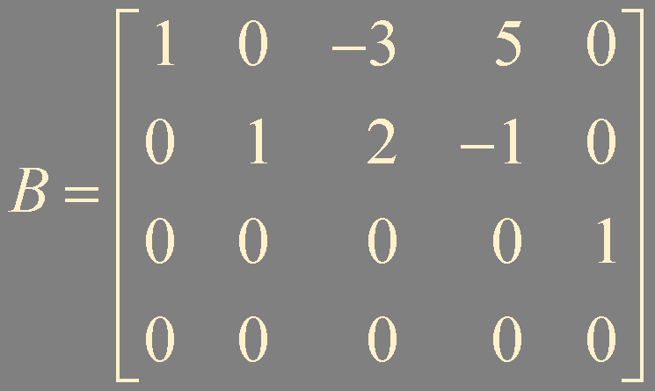
Example 5. Find a basis for the column space of the following matrix
{b₁, b₂, b₅} spans Col B

Slide 12
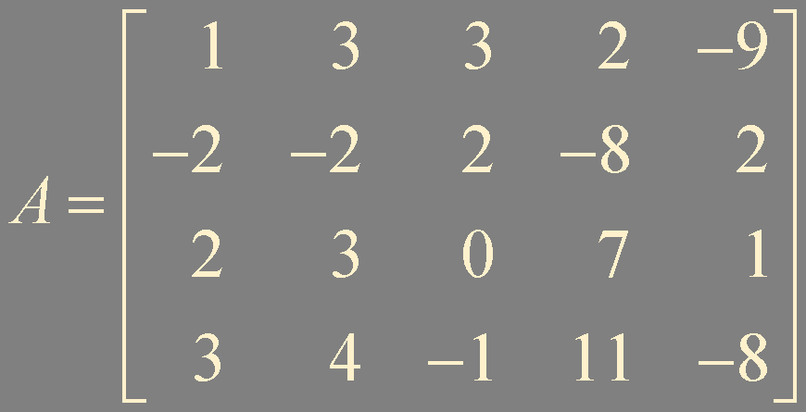

Example 6. Find a basis for the column space of the following matrix
row operations do not affect linear dependence relations among the columns of the matrix
{a₁, a₂, a₅} spans Col A
Col A ≠ Col B

Slide 13
Theorem 12.
The pivot columns of a matrix A form a basis for the column space of A

Slide 14
Summary
Subspace
Column space
Null space
Basis

